Slide 1

BASIC ELECTRICAL AND ELECTRONICS ENGINEERING
Course Code: CSE1002
SCHOOL OF COMPUTER SCIENCE ENGINEERING AND APPLICATIONS
Mrunmayee Rahate
Assistant Professor, DYPIU

Slide 2
Module 4: Operational Amplifiers (OP-AMPS)
Lecture 2: Applications of OP-AMP: Voltage Follower, Adder, Subtractor, Integrator and Differentiator

Slide 3
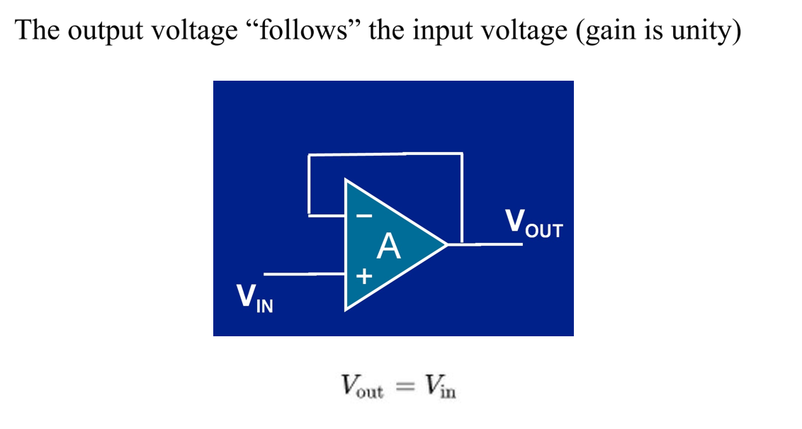
Operational Amplifier: Application as a voltage follower (Buffer Amplifier)

Slide 4
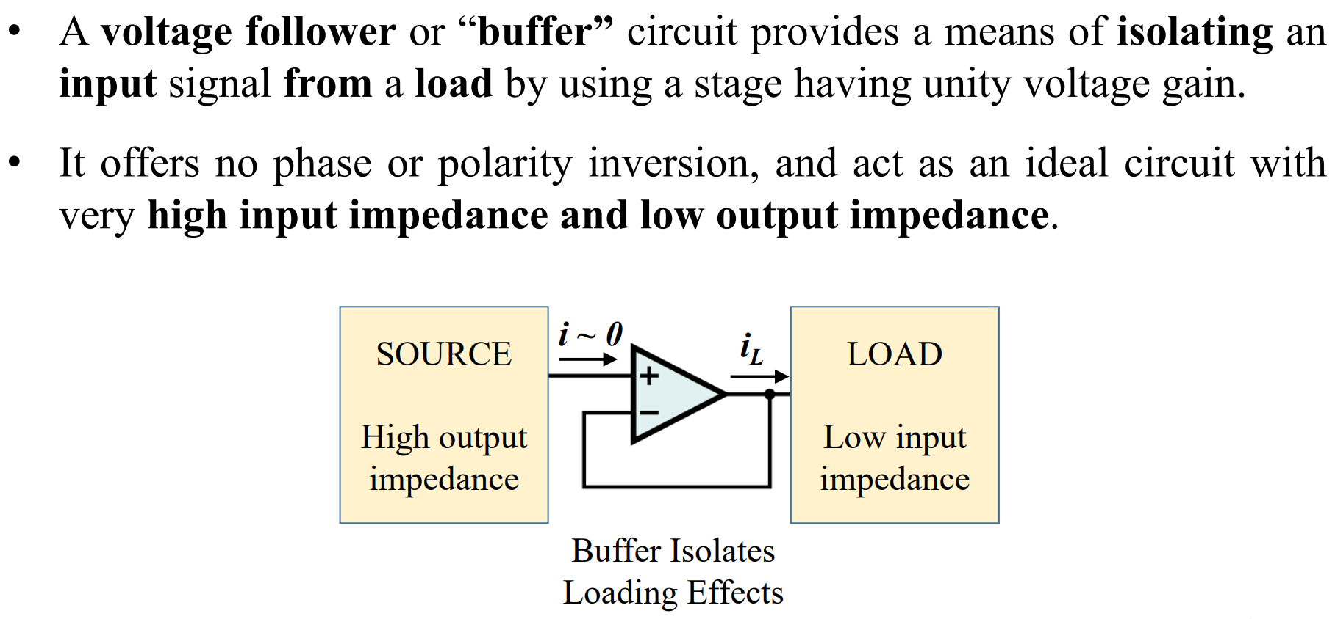
Operational Amplifier: Application as a voltage follower (Buffer Amplifier)

Slide 5
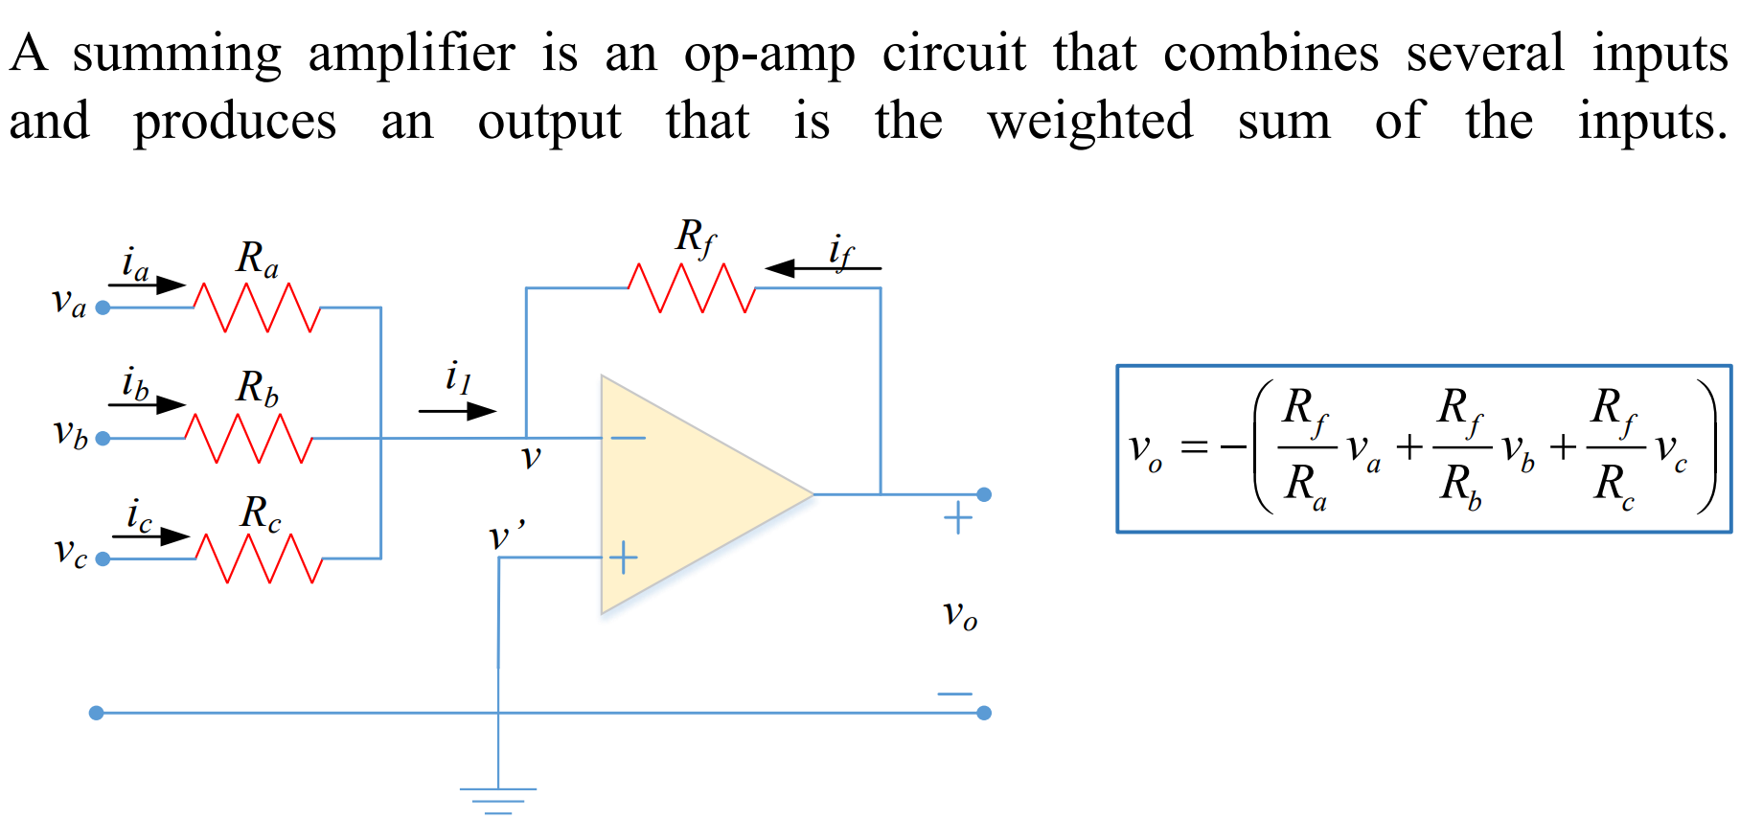
Operational Amplifier: Application as an adder (summing Amplifier)

Slide 6
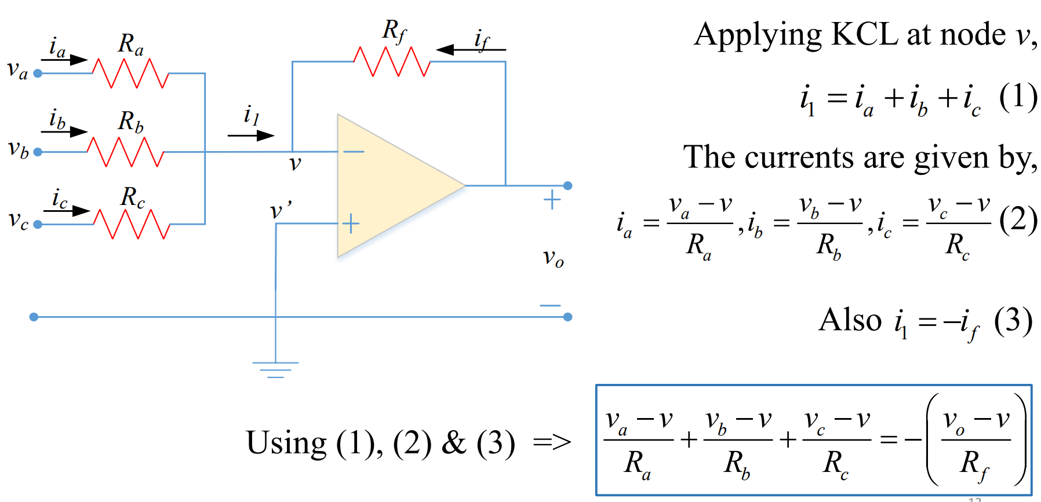
Operational Amplifier: Application as an adder (summing Amplifier)

Slide 7
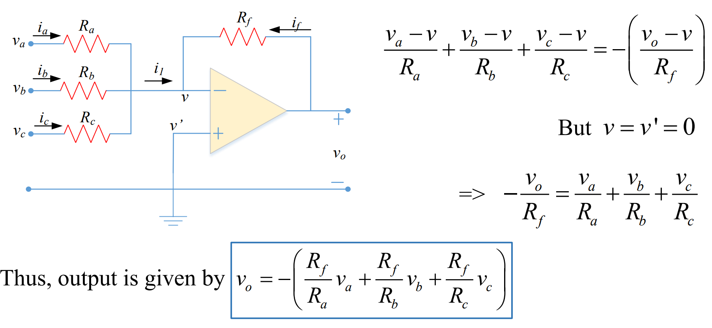
Operational Amplifier: Application as an adder (summing Amplifier)

Slide 8
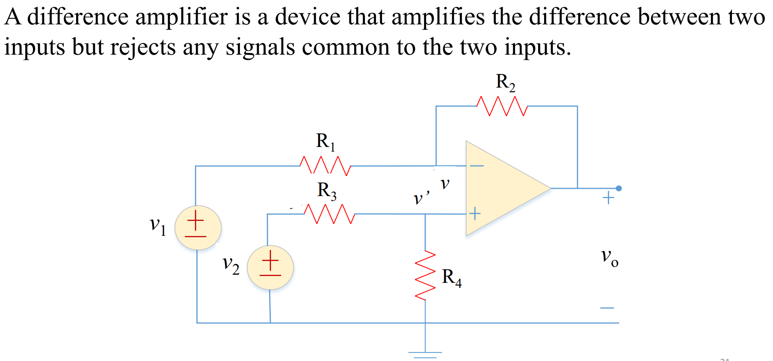
Operational Amplifier: Application as a subtractor (difference Amplifier)

Slide 9
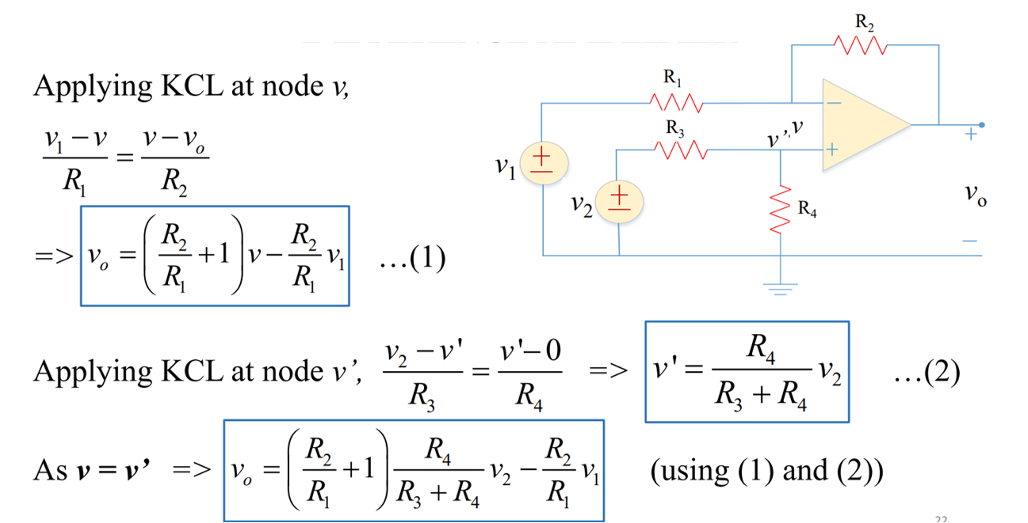
Operational Amplifier: Application as a subtractor (difference Amplifier)

Slide 10
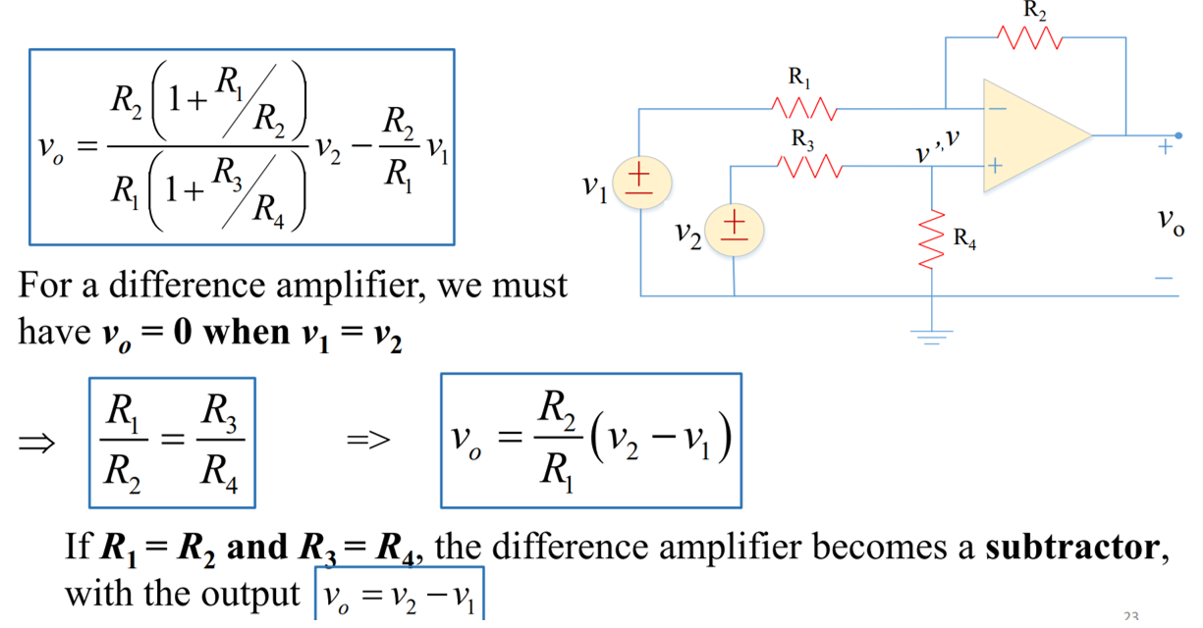
Operational Amplifier: Application as a subtractor (difference Amplifier)

Slide 11
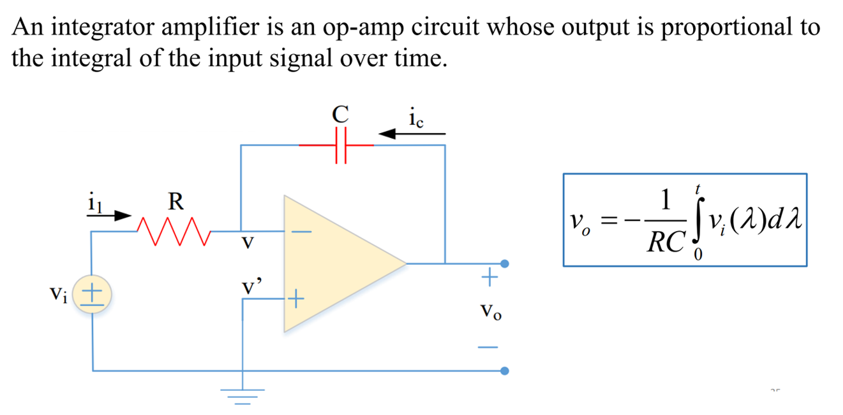
Operational Amplifier: Application as an integrator

Slide 12
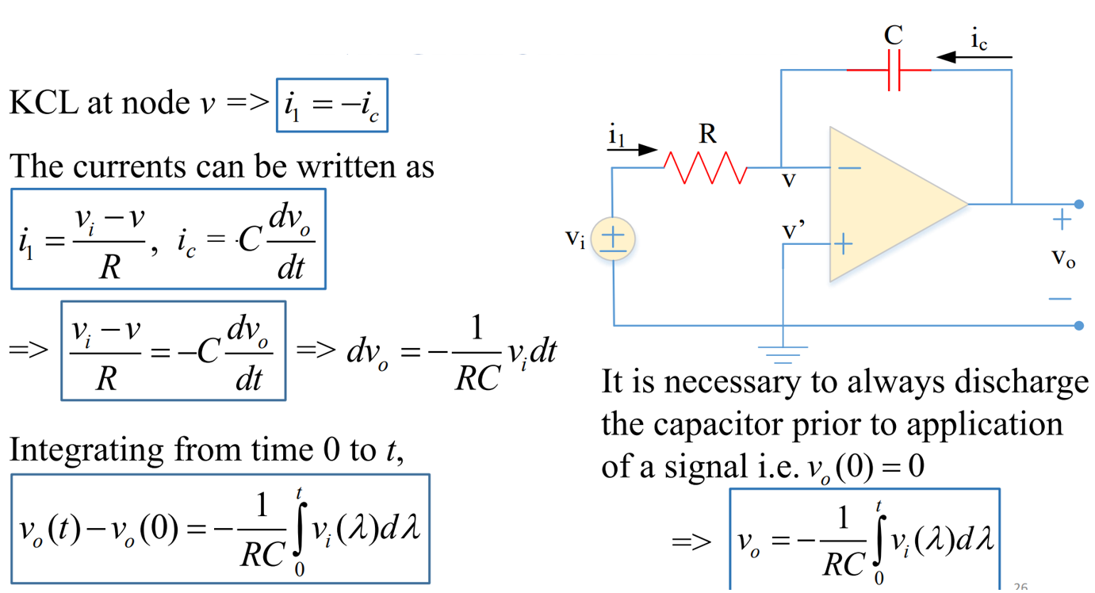
Operational Amplifier: Application as an integrator

Slide 13
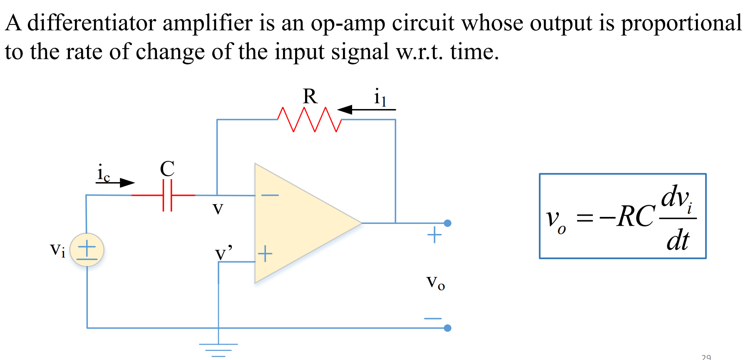
Operational Amplifier: Application as a differentiator

Slide 14
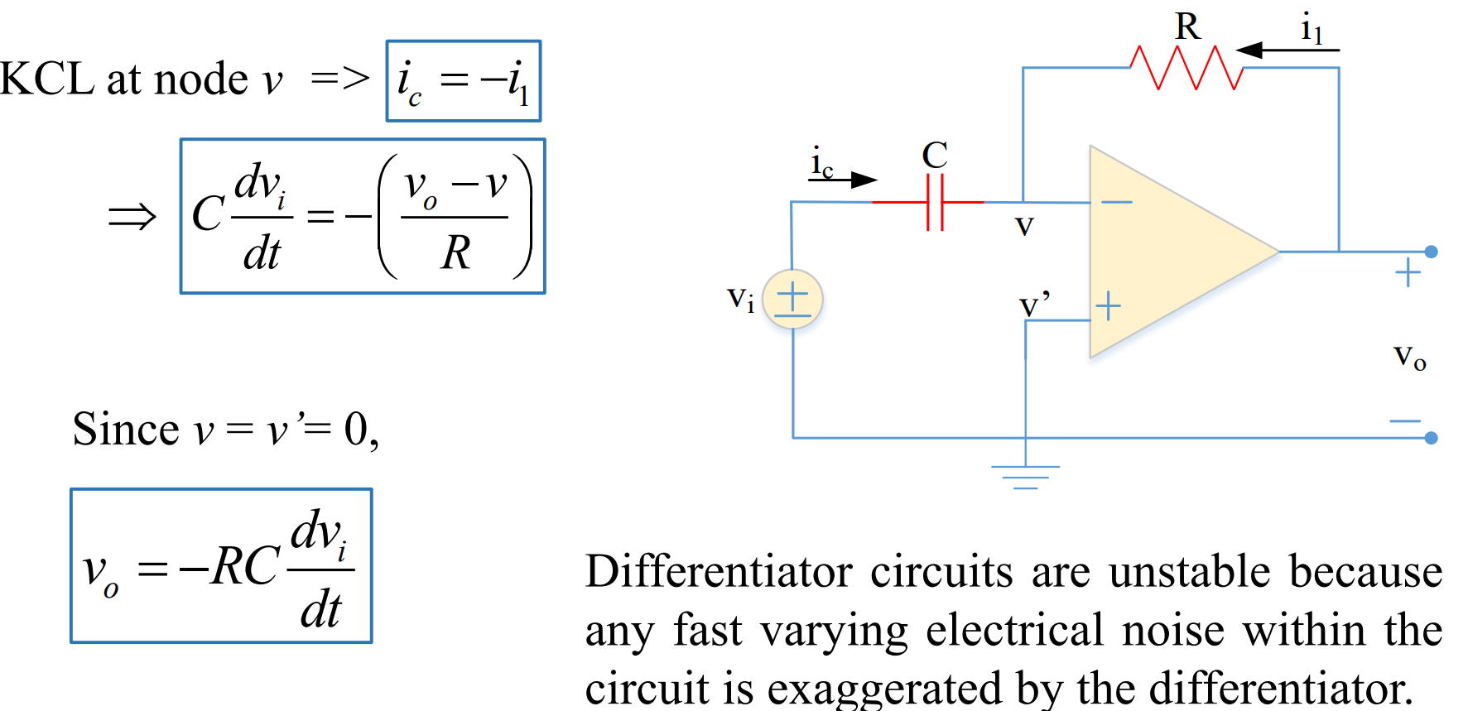
Operational Amplifier: Application as a differentiator

Slide 15
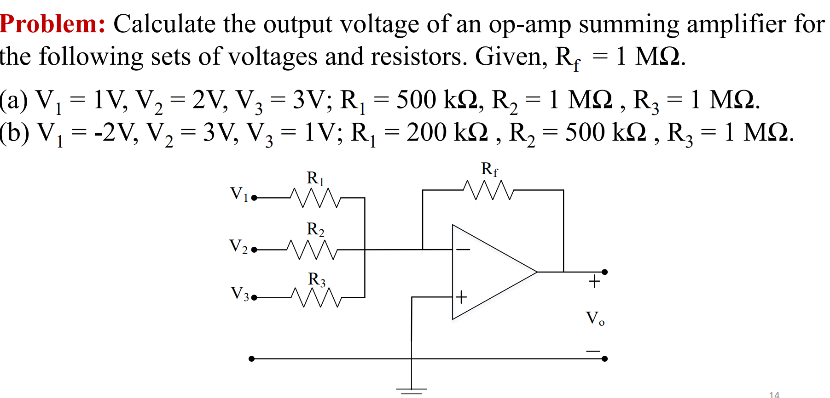
Operational Amplifier: numerical

Slide 16
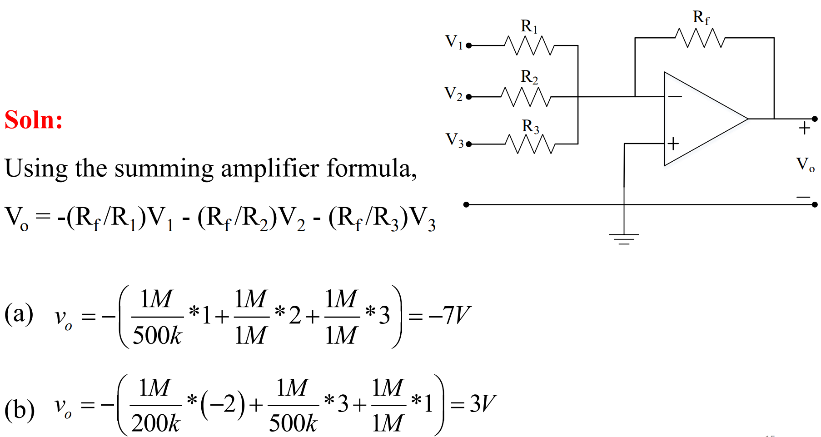
Operational Amplifier: numerical

Slide 17
Thank You !!!

